Slide 1
CS217 – Object Oriented Programming (OOP)
Week – 05
Feb 27- Mar 04, 2022
Instructor: Basit Ali

Slide 2
this Pointer
The this pointer holds the address of current object, in simple words you can say that this pointer points to the current object of the class.
Use?
When local variable’s name is same as member’s name
To return reference to the calling object

Slide 3
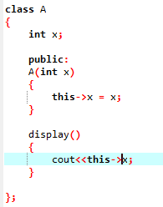
1) When local variable’s name is same as member’s name

Slide 4
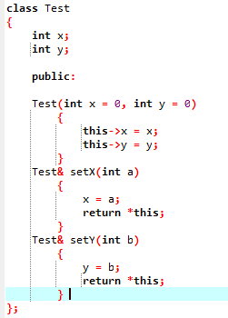
2) To return reference to the calling object

Slide 5
Inline Function
#include <iostream>
using namespace std;
inline int cube(int s)
{
return s*s*s;
}
int main()
{
cout << "The cube of 3 is: " << cube(3) << "\n";
return 0;
} //Output: The cube of 3 is: 27

Slide 6
Inline Function
Remember, inlining is only a request to the compiler, not a command. Compiler can ignore the request for inlining. Compiler may not perform inlining in such circumstances like:
1) If a function contains a loop. (for, while, do-while)
2) If a function contains static variables.
3) If a function is recursive.
4) If a function return type is other than void, and the return statement doesn’t exist in function body.
5) If a function contains switch or goto statement.

Slide 7
Inline functions provide following advantages
Function call overhead doesn’t occur.
It also saves the overhead of push/pop variables on the stack when function is called.
It also saves overhead of a return call from a function.
When you inline a function, you may enable compiler to perform context specific optimization on the body of function. Such optimizations are not possible for normal function calls. Other optimizations can be obtained by considering the flows of calling context and the called context.
Inline function may be useful (if it is small) for embedded systems because inline can yield less code than the function call preamble and return.

Slide 8
Array of objects
books book[size] ;
for(int i=0; i<size; i++)
{
cout<<"Enter details of book "<<(i+1)<<"\n";
book[i].getdata();
}
//declaration array of objects
//with parameterized constructor
Number N[3]={Number(10),Number(20),Number(30)};
Rectangle *ptr_arr[2];
ptr_arr[0] = new Rectangle(10,20);
ptr_arr[1] = new Rectangle(15,5);

Slide 9
Object Relationship
is-a relationship
has-a relationship

Slide 10
has-a Relationship
In a has-a relationship, an object contains one or more objects of other classes as members
A car has a steering
An office has a department

Slide 11
has-a Relationship
class Office
{
Department d;
// any other members
};

Slide 12
is-a Relationship
Sometimes, one class is an extension of another class
A car is a vehicle Cricket is a sport

Slide 13
is-a Relationship
The extended (or child) class contains all the features of its base (or parent) class, and may additionally have some unique features of its own
The key idea behind inheritance

Slide 14
Inheritance
Capability of a class to derive properties and characteristics from another class.
One of the most important feature of Object Oriented Programming

Slide 15
Concepts
Sub Class: The class that inherits properties from another class is called Sub class or Derived Class or Child Class.
Super Class: The class whose properties are inherited by sub class is called Base Class or Super class or Parent Class.

Slide 16
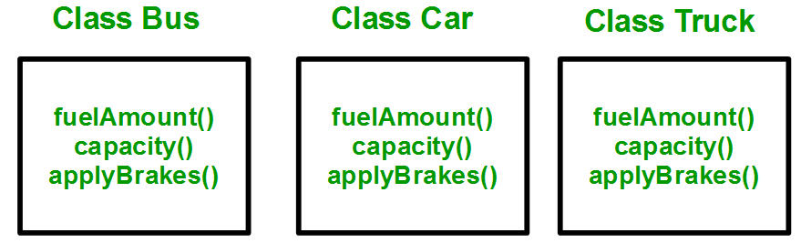
Why and when to use inheritance?
Consider a group of vehicles. You need to create classes for Bus, Car and Truck. The methods fuelAmount(), capacity(), applyBrakes() will be same for all of the three classes.

Slide 17
Why and when to use inheritance?
You can clearly see that above process results in duplication of same code 3 times. This increases the chances of error and data redundancy. To avoid this type of situation, inheritance is used.

Slide 18
Why and when to use inheritance?
If we create a class Vehicle and write these three functions in it and inherit the rest of the classes from the vehicle class, then we can simply avoid the duplication of data and increase re-usability.

Slide 19
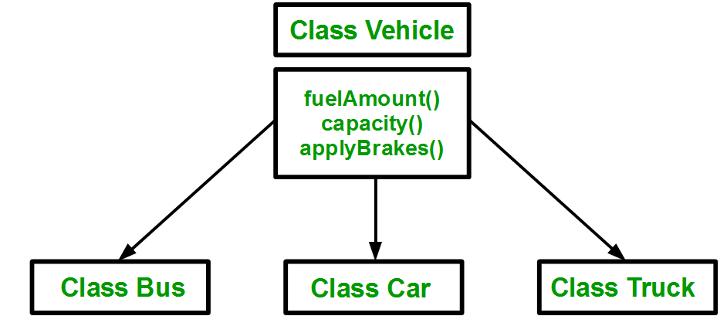
Why and when to use inheritance?

Slide 20
Implementing inheritance in C++
Syntax:
class subclass_name : access_mode base_class_name
{
//body of subclass
};

